Slide 1
Singleton Pattern
Design Patterns
Howard Zhou
Longan Team

Slide 2
Motivating Example
Some classes should have exactly one instance
Examples:
Access to a computer’s filesystem
Access to a network’s printer spooler
Access to an operating system’s windowmanager
Commonly, singletons should only be created when they are first needed (e.g. lazy construction)

Slide 3
Intent
Ensure a class has only one instance
Make the class itself responsible for keeping track of its sole instance
“There can be only one”

Slide 4
Applicability
There must be one and only one instance of a class
The class must be accessible to clients
The class should not require parameters as part of its construction
When creating the instance is expensive, a Singleton can improve performance

Slide 5
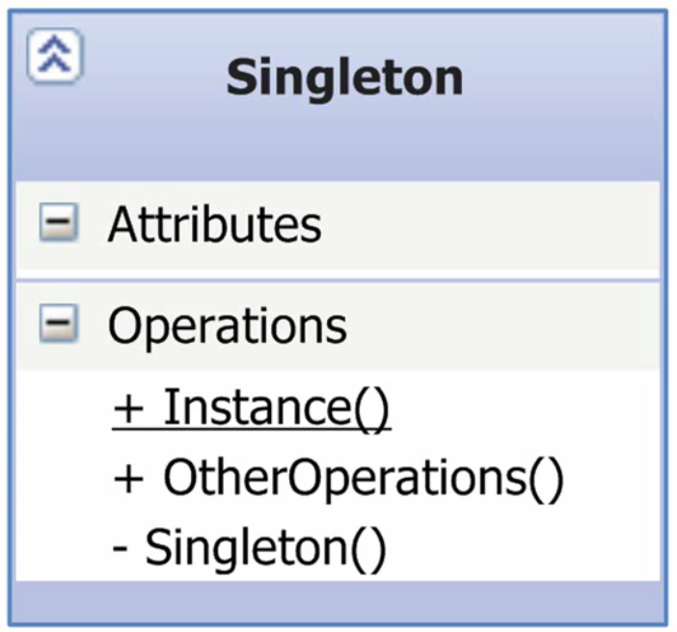
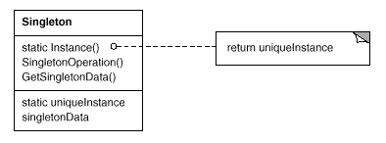
Structure

Slide 6
Demo
Not Thread-Safe

Slide 7
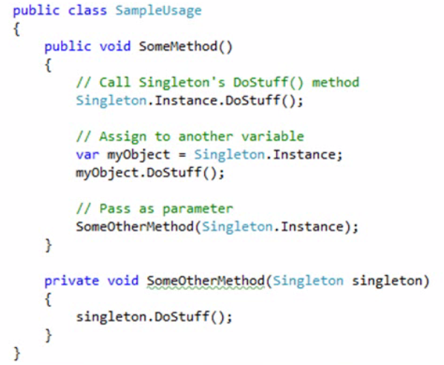
How it get used
Call methods on Instance directly
Assign variables to Instance
Pass as parameter

Slide 8
Demo
Thread-safe and fast

Slide 9
Collaboration
Classes that need to interact directly with a Singleton must refer to its Instance property(or method)
Alternately, classes can depend on an interface or parameter of the Singleton’s type

Slide 10
Consequences
The default implementation of the Singleton pattern is not thread-safe and should not be used in multi-threaded environments, including web servers (e.g.ASP.NET)
Singletons introduce tight coupling among collaborating classes
Singletons are notoriously difficult to test
Commonly regarded as an anti-pattern
Using an IOC Container it is straightforward to avoid the coupling and testability issues

Slide 11
Single Responsibility
Management of object lifetime is a separate responsibility
Adding this responsibility to a class with other responsibilities violates the Single Responsibility Principle (SRP)
Using an IOC Container , a separate class can be responsible for managing object lifetime

Slide 12
Implementation Example
Logging to a common file
Using separate instance classes
Using a Singleton for performance reasons
Introducing locking
Introducing double-check locking
Introducing lazy instantiation via statics
Execution Modes
Single-threaded
Multi-threaded (in Parallel)

Slide 13
Demo
https://app.pluralsight.com/player?course=patterns-library&author=steve-smith&name=patterns-singleton&clip=11&mode=live

Slide 14
Related Patterns
Abstract Factory
Factory Method
Builder
See also: Static Classes

Slide 15
References
Books
Design Patterns, http://amzn.to/95q9ux
Design Patterns Explained, http://amzn.to/cr8Vxb
Design Patterns in C#, http://amzn.to/bqJgdU
Head First Design Patterns, http://amzn.to/aA4RS6
C# in Depth, http://amzn.to/djDzZw
Online
Implementing the Singleton Pattern in C#
http://csharpindepth.com/Articles/General/Singleton.aspx

Slide 16
Summary
The Singleton Pattern is one of the simplest design patterns
It is used to ensure that only exactly one instance of a class exists within a program
Though simple, it is easy to get wrong, and can result in a more brittle and less testable design
Object lifetime management is usually better handled by a container with this responsibility

